Slide 1
Chapter 8
Classes and Data Abstraction

Slide 2
Objectives (1 of 2)
In this chapter, you will:
  Learn about classes
  Learn about private, protected, and public members of a class
  Explore how classes are implemented
  Become aware of accessor and mutator functions
  Examine constructors and destructors

Slide 3
Objectives (2 of 2)
  Learn about the abstract data type (ADT)
  Explore how classes are used to implement ADTs
  Become aware of the differences between a struct and a class
  Learn about information hiding
  Explore how information hiding is implemented in C++
  Become aware of inline functions of a class
  Learn about the static members of a class

Slide 4
Classes (1 of 4)
Object-oriented design (OOD): a problem solving methodology
Object: combines data and the operations on that data in a single unit
Class: a collection of a fixed number of components
Member: a component of a class

Slide 5
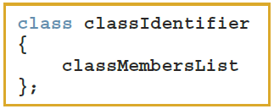
Classes (2 of 4)
The general syntax for defining a class:
A class member can be a variable or a function
If a member of a class is a variable
  It is declared like any other variable
  You cannot initialize a variable when you declare it

Slide 6
Classes (3 of 4)
If a member of a class is a function
  A function prototype declares that member
  Function members can (directly) access any member of the class
A class definition defines only a data type
  No memory is allocated
  Remember the semicolon (;) after the closing brace

Slide 7
Classes (4 of 4)
Three categories of class members:
  private (default)
    Member cannot be accessed outside the class
  public
    Member is accessible outside the class
  protected

Slide 8
Unified Modeling Language Class Diagrams (1 of 2)
Unified Modeling Language (UML) notation: used to graphically describe a class and its members
  +: member is public
  -: member is private
  #: member is protected

Slide 9
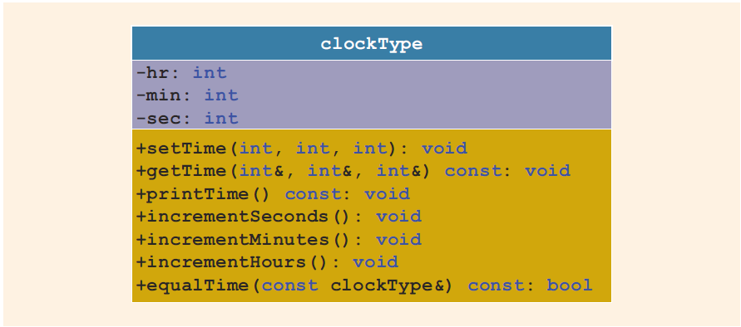
Unified Modeling Language Class Diagrams (2 of 2)
FIGURE 10-1 UML class diagram of the class clockType

Slide 10

Variable (Object) Declaration
Once defined, you can declare variables of that class type
  clockType myClock;
  clockType yourClock;
A class variable is called a class object or class instance
FIGURE 10-2 Objects myClock and yourClock

Slide 11

Accessing Class Members
Once an object is declared, it can access the members of the class
The general syntax for an object to access a member of a class:
If an object is declared in the definition of a member function of the class, it can access the public and private members
The dot (.) is the member access operator

Slide 12
Built-in Operations on Classes
Most of C++’s built-in operations do not apply to classes
  Arithmetic operators cannot be used on class objects unless the operators are overloaded
  Relational operators cannot be used to compare two class objects for equality
Built-in operations that are valid for class objects:
  Member access (.)
  Assignment (=)

Slide 13
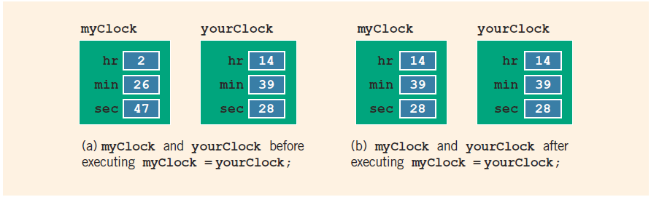
Assignment Operator and Classes
FIGURE 10-3 myClock and yourClock before and after executing the statement
myClock = yourClock;

Slide 14
Class Scope (1 of 2)
A class object can be automatic or static
  Automatic: created when the declaration is reached and destroyed when the surrounding block is exited
  Static: created when the declaration is reached and destroyed when the program terminates
A member of a class has the same scope as a member of a struct

Slide 15
Class Scope (2 of 2)
A member of the class is local to the class
You access a class member outside the class by using the class object name and the member access operator (.)

Slide 16
Functions and Classes
Objects can be passed as parameters to functions and returned as function values
As parameters to functions:
  Class objects can be passed by value or by reference
If an object is passed by value:
  Contents of data members of the actual parameter are copied into the corresponding data members of the formal parameter

Slide 17
Reference Parameters and Class Objects (Variables) (1 of 2)
Passing by value might require a large amount of storage space and a considerable amount of computer time to copy the value of the actual parameter into the formal parameter
If a variable is passed by reference:
  The formal parameter receives only the address of the actual parameter

Slide 18
Reference Parameters and Class Objects (Variables) (2 of 2)
Pass by reference is an efficient way to pass a variable as a parameter
  Problem: when passing by reference, the actual parameter changes when the formal parameter changes
  Solution: use const in the formal parameter declaration

Slide 19
Implementation of Member Functions (1 of 4)
Must write the code for functions defined as function prototypes
Prototypes are left in the class to keep the class smaller and to hide the implementation
To access identifiers local to the class, use the scope resolution operator, (::)

Slide 20
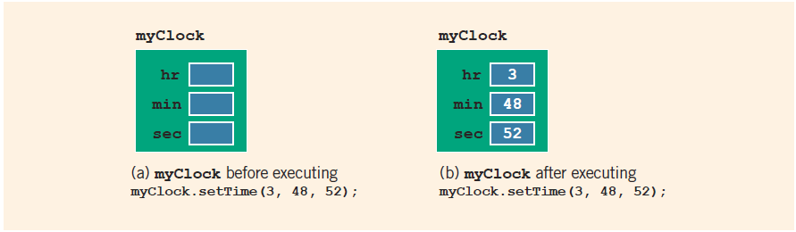
Implementation of Member Functions (2 of 4)
FIGURE 10-4 myClock before and after executing the statement
myClock.setTime(3, 48, 52);

Slide 21

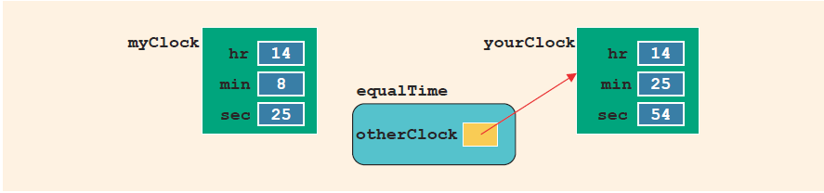
Implementation of Member Functions (3 of 4)
FIGURE 10-5 Objects myClock and yourClock
FIGURE 10-6 Object myClock and parameter otherClock

Slide 22
Implementation of Member Functions (4 of 4)
Once a class is properly defined and implemented, it can be used in a program
  A program that uses/manipulates objects of a class is called a client of that class
When you declare objects of the class clockType, each object has its own copy of the member variables (hr, min, and sec)
  These variables are called instance variables of the class
  Every object has its own copy of the data

Slide 23
Accessor and Mutator Functions
Accessor function: member function that only accesses the value(s) of member variable(s)
Mutator function: member function that modifies the value(s) of member variable(s)
Constant member function
  Member function that cannot modify member variables of that class
  Member function heading with const at the end

Slide 24
Order of public and private Members of a Class
C++ has no fixed order in which to declare public and private members
By default, all members of a class are private
Use the member access specifier public to make a member available for public access

Slide 25
Constructors (1 of 2)
Use constructors to guarantee that member variables of a class are initialized
Two types of constructors
  With parameters
  Without parameters (default constructor)
Other properties of constructors
  Name of a constructor is the same as the name of the class
  A constructor has no type

Slide 26
Constructors (2 of 2)
A class can have more than one constructor
  Each must have a different formal parameter list
Constructors execute automatically when a class object enters its scope
  They cannot be called like other functions
Which constructor executes depends on the types of values passed to the class object when the class object is declared

Slide 27
Invoking a Constructor
A constructor is automatically executed when a class variable is declared
Because a class may have more than one constructor, you can invoke a specific constructor

Slide 28

Invoking the Default Constructor
Syntax to invoke the default constructor is:
The statement:
  clockType yourClock;
  declares yourClock to be an object of type clockType and the default constructor executes

Slide 29
Invoking a Constructor with Parameters
The syntax to invoke a constructor with a parameter is:
Number and type of arguments should match the formal parameters (in the order given) of one of the constructors
  Otherwise, C++ uses type conversion and looks for the best match
  Any ambiguity causes a compile-time error

Slide 30
Constructors and Default Parameters
A constructor can have default parameters
  Rules for declaring formal parameters are the same as for declaring default formal parameters in a function
  Actual parameters are passed according to the same rules for functions
A default constructor is a constructor with no parameters or with all default parameters

Slide 31
Classes and Constructors: A Precaution
If a class has no constructor(s), C++ provides the default constructor
  However, the object declared is still uninitialized
If a class includes constructor(s) with parameter(s), but not the default constructor
  C++ does not provide the default constructor
  Appropriate arguments must be included when the object is declared

Slide 32
In-line Initialization of Data Members and the Default Constructor
C++11 standard allows member initialization in class declarations
  Called in-line initialization of the data members
When an object is declared without parameters, then the object is initialized with the in-line initialized values
  If declared with parameters, then the default values are overridden by the constructor with the parameters

Slide 33
Arrays of Class Objects (Variables) and Constructors
If you declare an array of class objects, the class should have the default constructor
  The default constructor is typically used to initialize each (array) class object

Slide 34
Destructors
Destructors are functions without any type
A class can have only one destructor
  The destructor has no parameters
The name of a destructor is the tilde character (~) followed by the class name
  Example: ~clockType();
The destructor automatically executes when the class object goes out of scope

Slide 35
Data Abstract, Classes, and Abstract Data Types
Abstraction
  Separating design details from usage
  Separating the logical properties from the implementation details
Abstraction also applicable to data
Abstract data type (ADT): a data type that separates the logical properties from the implementation details
Three things associated with an ADT
  Type name: the name of the ADT
  Domain: the set of values belonging to the ADT
  Set of operations on the data

Slide 36
A struct versus a class (1 of 2)
By default, members of a struct are public
  private specifier can be used in a struct to make a member private
By default, the members of a class are private
classes and structs have the same capabilities

Slide 37
A struct versus a class (2 of 2)
In C++, the definition of a struct was expanded to include member functions, constructors, and destructors
If all member variables of a class are public and there are no member functions:
  Use a struct

Slide 38
Information Hiding (1 of 3)
Information hiding refers to hiding the details of the operations on the data
The header file (or interface file) contains the specification details
  The header file has an extension h
The implementation file contains the definitions of the functions to implement the operations of an object
  This file has an extension cpp
In the header file, include function prototypes and comments that briefly describe the functions
  Specify preconditions and/or postconditions

Slide 39
Information Hiding (2 of 3)
Implementation file must include the header file via the include statement
In the include statement:
  User-defined header files are enclosed in double quotes
  System-provided header files are enclosed between angular brackets

Slide 40
Information Hiding (3 of 3)
Precondition: a statement specifying the condition(s) that must be true before the function is called
Postcondition: a statement specifying what is true after the function call is completed

Slide 41
Executable Code
To use an object in a program
  The program must be able to access the implementation details of the object
IDEs Visual C++ Express (2013 or 2016) and Visual Studio 2015, and C++ Builder put the editor, compiler, and linker into a package
  One command (build, rebuild, or make) compiles program and links it with the other necessary files
  These systems also manage multiple file programs in the form of a project

Slide 42
More Examples of Classes
Various examples of classes and how to use them in a program are presented
Refer to Example 10-8 through Example 10-11

Slide 43
Inline Functions
An inline function definition is a member function definition given completely in the definition of the class
  Saves the overhead of a function invocation
Very short definitions should be defined as inline functions

Slide 44
static Members of a Class (1 of 2)
Use the keyword static to declare a function or variable of a class as static
A public static function or member of a class can be accessed using the class name and the scope resolution operator
static member variables of a class exist even if no object of that class type exists

Slide 45
static Members of a Class (2 of 2)
Multiple objects of a class each have their own copy of non-static member variables
All objects of a class share any static member of the class

Slide 46
Quick Review (1 of 3)
A class is a collection of a fixed number of components
Components of a class are called the members of the class
  Accessed by name
  Classified into one of three categories: private, protected, and public
In C++, class variables are called class objects or class instances or, simply, objects

Slide 47
Quick Review (2 of 3)
The only built-in operations on classes are assignment and member selection
Constructors guarantee that data members are initialized when an object is declared
  A default constructor has no parameters
The destructor automatically executes when a class object goes out of scope
  A class can have only one destructor
  The destructor has no parameters

Slide 48
Quick Review (3 of 3)
An abstract data type (ADT) is a data type that separates the logical properties from the implementation details
A public static member, function or data, of a class can be accessed using the class name and the scope resolution operator, ::
static member variables of a class exist even when no object of the class type exists
Instance variables are non-static data members

